Slide 1

Random Starts using Mplus
9/14/2023
Dina Arch
IMMERSE Project – IES Funded Training Program

Slide 2
Visit our Github!
Please visit our GitHub to access all the materials you need for our tutorials:
https://github.com/immerse-ucsb

Slide 3
What are random starts in LCA?
Mplus uses an expectation-maximization (EM) algorithm
Iterative method to find the local maximum likelihood estimates of parameters in statistical models
Default in Mplus
Challenge of EM:
The estimation may fail to converge even if the model is theoretically identified
If the estimation algorithm does converge, since the log likelihood surface for mixtures if often multimodal, there is no way to prove the solution is a global rather than local maximum
Due to the potential for multiple local maxima in the likelihood surface, the algorithm's convergence can depend heavily on the initial starting values of the parameters.

Slide 4
What are random starts in LCA? Continued…
Use multiple random sets of (initialization) starting values with the estimation algorithm—it is recommended that a minimum of 50 to 100sets of extensively, randomly varied starting values are used (Hipp & Bauer, 2006) but more may be necessary to observe satisfactory replication of the best maximum log likelihood value, particularly as you increase the number of classes.
Recommendations for a more thorough investigation of multiple solutions when there are more than two classes:
ANALYSIS: Starts = 100 20;
or with many classes
ANALYSIS: Starts = 500 100;
`STARTS` specifies that Mplus should begin with 100 random sets of starting values (initial starts) and then use the best 20 solutions for more detailed final optimization.

Slide 5
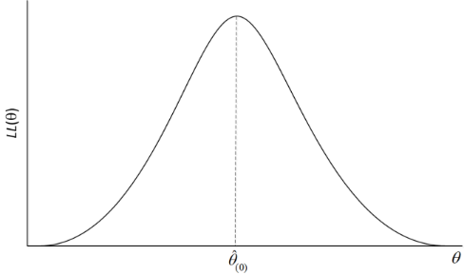
Each value ϴ_{i} implies a specific set of parameters (e.g., conditional item probabilities, etc.)
Goal: pick a ϴ_{i} that maximized the likelihood
Likelihood Value
Parameter set

Slide 6
Each value ϴ_{i} implies a specific set of parameters (e.g., conditional item probabilities, etc.)
Goal: pick a ϴ_{i} that maximized the likelihood

Slide 7

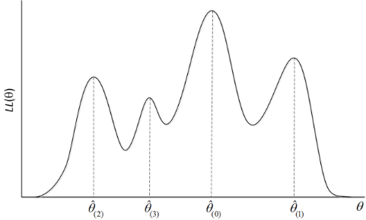

Slide 8
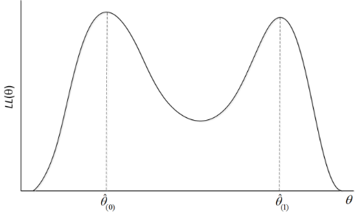
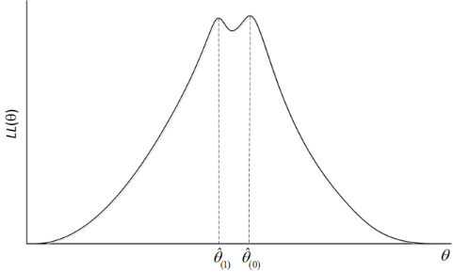
Example of to sets of parameter values ( ϴ’s) that lead to very similar likelihood values
These parameter values are far apart.
These parameter values are close

Slide 9
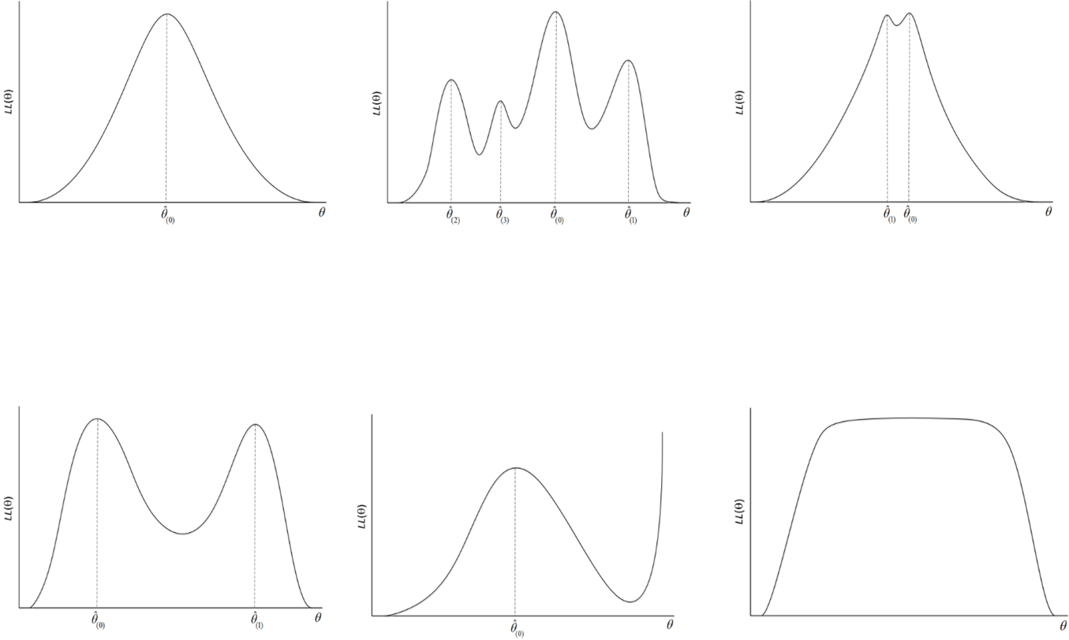

Slide 10


Random Start Values (EM Step 1)
Use multiple random sets of (initialization) starting values with the estimation algorithm
It is recommended that a minimum of 50 to 100 sets randomly varied starting values are used (Hipp & Bauer, 2006) but more may be necessary to observe satisfactory replication of the best maximum log likelihood value, particularly as you increase the number of classes.
Recommendations for a more thorough investigation of multiple solutions when there are more than two classes:
ANALYSIS: Starts = 100 20;
or with many classes
ANALYSIS: Starts = 500 100;

Slide 11
Consider this analysis example
We estimate a mixture model with 100 sets of random starts.
Those 100 will iterate for a fixed amount of time.
The 20 models that had the best log likelihood values after that fixed time will then be picked and estimated ALL THE WAY.
Analysis:
type = mixture;
starts = 100 20;

Slide 12
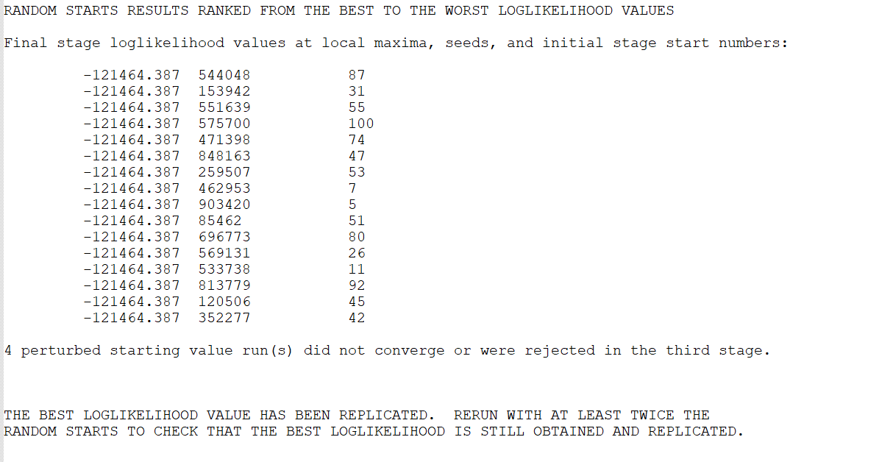
Analysis:
type = mixture;
starts = 100 20;
16 of the 20 converged on the exact same value of the log likelihood and 4 did not converge.
This is a good result but at least one more run is necessary.
Mplus will print this message every time.

Slide 13
The value of the local maxima and the seed are most relevant.
How you can interpret this: The random seed of 544048 lead to a likelihood value of -121464.387.
The random seed of 153942 also lead to a likelihood value of -121464.387….

Slide 14

Studying the likelihood values, we see that the same likelihood value is repeated for all the 16 models that converged. That is, 16 different random seeds lead to the same solution. This helps us feel confident that the estimated model parameters reported in this output is from a global maximum, not a local one.

Slide 15
A different example
Analysis:
type = mixture;
starts = 500 100;

Slide 16
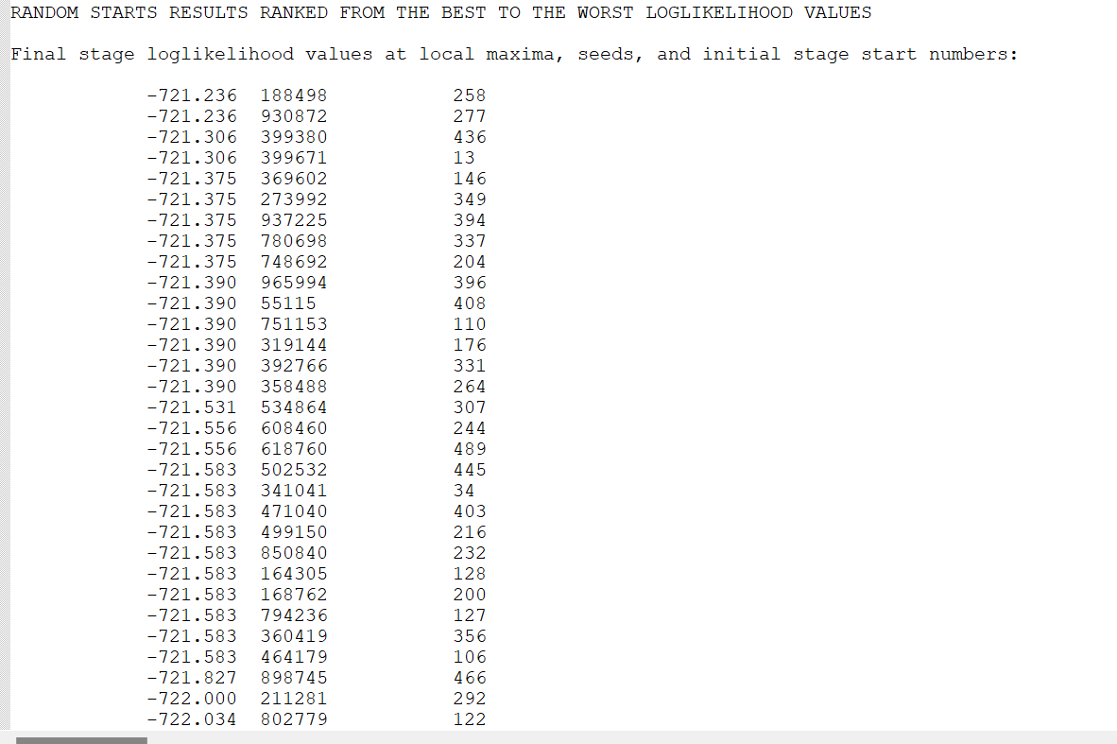

Slide 17
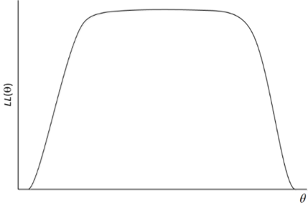
In this situation, there are a lot of random seeds that converged on likelihood values that are very similar. This is not ideal.
Need to rerun with more random starts… perhaps, starts = 2000 500;
Analysis:
type = mixture;
starts = 0;
optseed = 399380;
We don’t know if these solutions are from the distribution on the left or the right.

Slide 18
You could also dig deeper to see if the two best solution were the same. To do this, you can estimate the model with the second best solution and compare parameter estimates.
Specify a model where you turn off random starts (starts=0) and then tell Mplus with seed to use (optseed =399380;)
Then compare model parameters of this model to the previous one.
Analysis:
type = mixture;
starts = 0;
optseed = 399380;

Slide 19
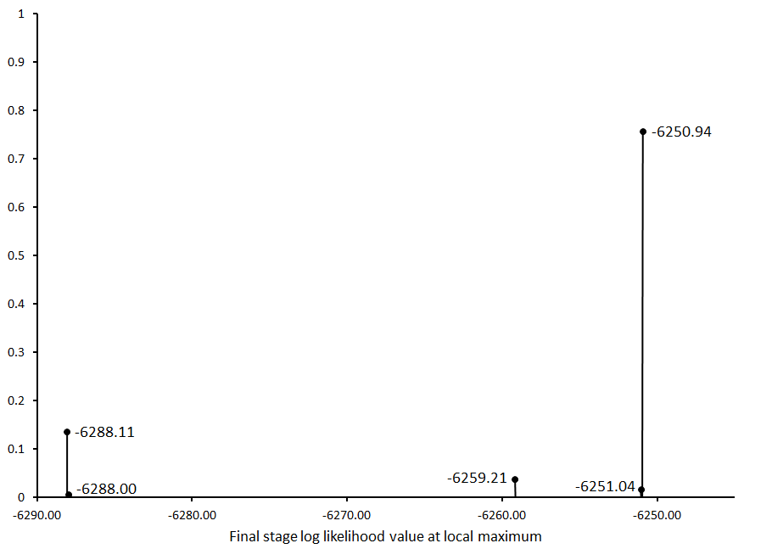
This likelihood was the most frequent one, but is far from the best.
Most frequent log likelihood ≠ best solution
This likelihood was the not the most frequent but is the best.
Note: LL replication is neither necessary or sufficient for a given solution to be the global maximum.

Slide 20

Model Estimation Tracking
n= |  |  |  | # response patterns =
1338 |  |  |  | 32 |  | Final starting value sets converging |  | LL replication |  | Smallest class
Model | K= | Best LL | npar | Starts = |  | f | % | f | % | f | % | Condition Number
1-class | 1 | -4102.59 | 5 | 100 | 50 | 50 | 100% | 50 | 100% | 1338 | 100% | 2.00E-01
Of the 50 second stage start values specific, 50 (100%) converged
Of the 50 that converged, 50 of them (100%) replicated the best log likelihood value
This is the size of the smallest class, which is just helpful to report as a glimpse into the solutoin

